Slide 1
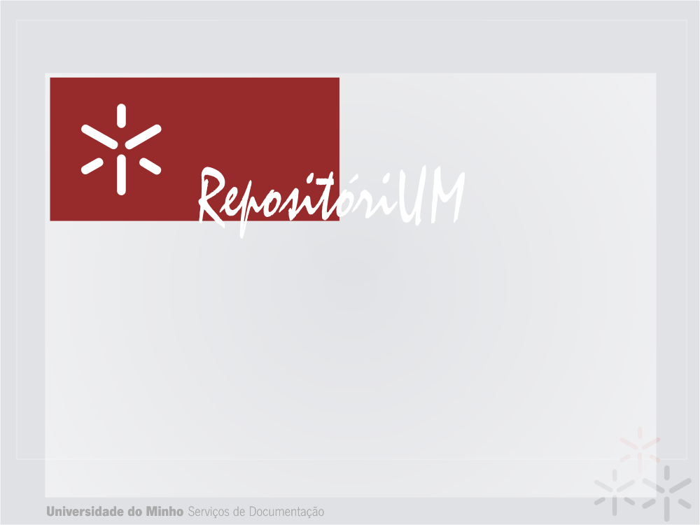
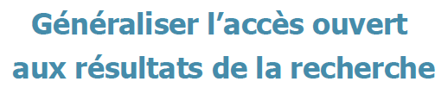


Open Access policy at UMinho: incentive and mandate
Eloy Rodrigues
eloy@sdum.uminho.pt

Slide 2
Agenda
Introduction – University of Minho
  Open Access @UMinho
Open Access Policy @UMinho: incentive and mandate
  The 2004 policy - results
  The policy upgrade in 2010 – current results
Future directions

Slide 3
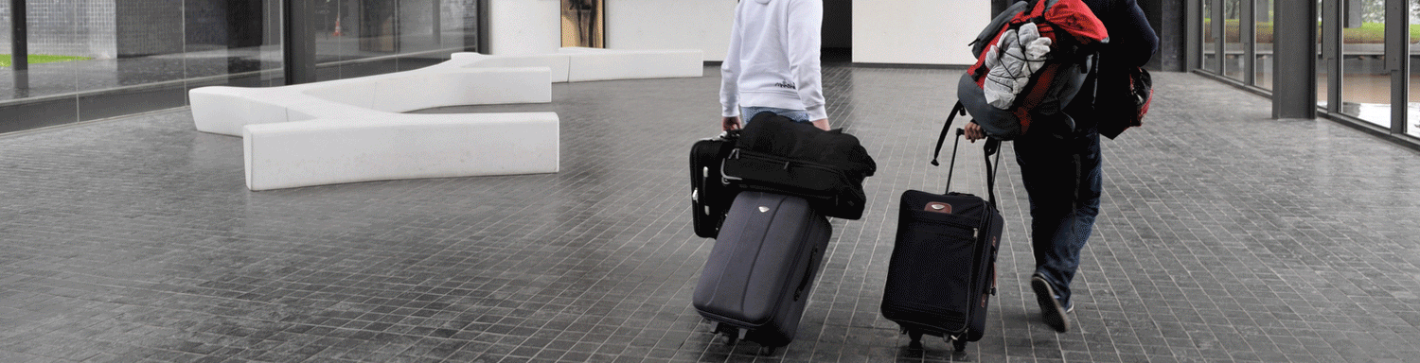

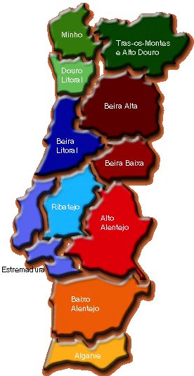
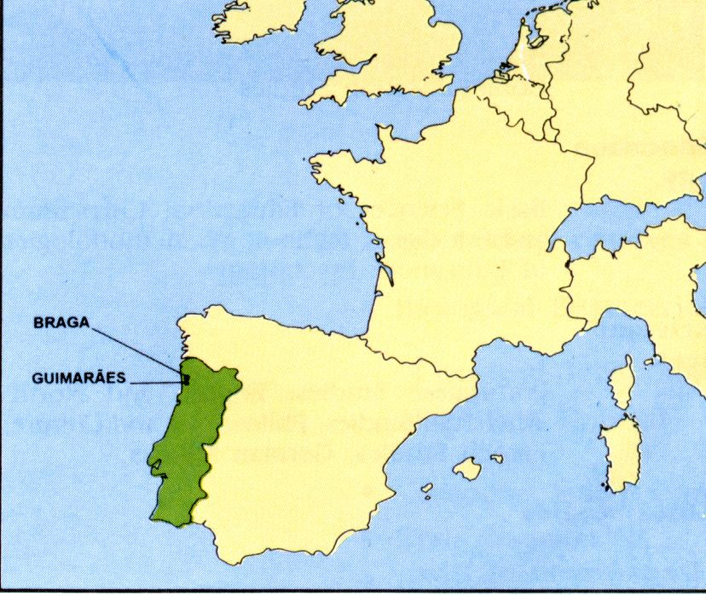

Slide 4
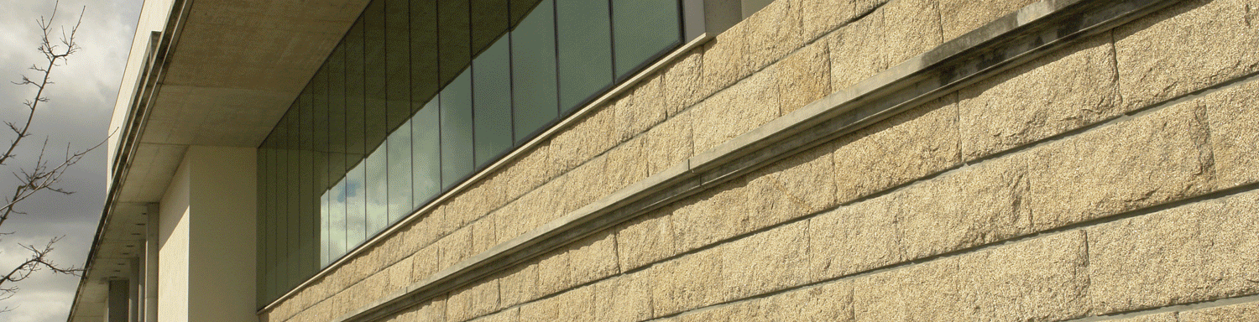
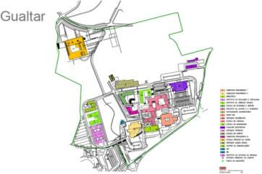
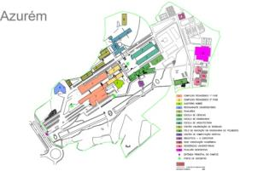
1974 (39 years)
2 Campi
• Campus de Gualtar (380.000 m²)
Braga
• Campus de Azurém (270.000 m²)
Guimarães

Slide 5
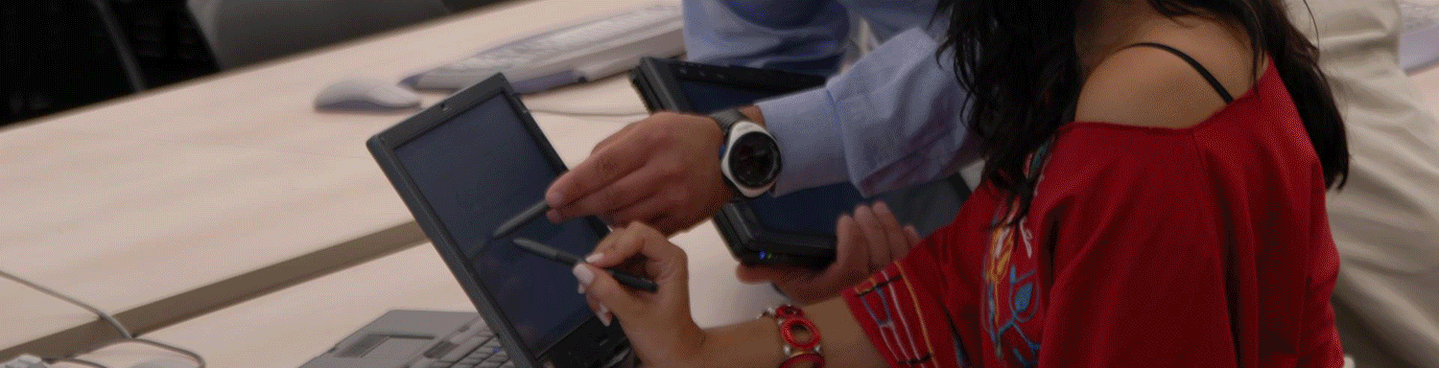
teaching
• 53 graduate courses
• 130 masters courses
• 22 PHD courses
• 18.500 students
12.300 graduate students
4.400 master students
1.900 PHD students

Slide 6
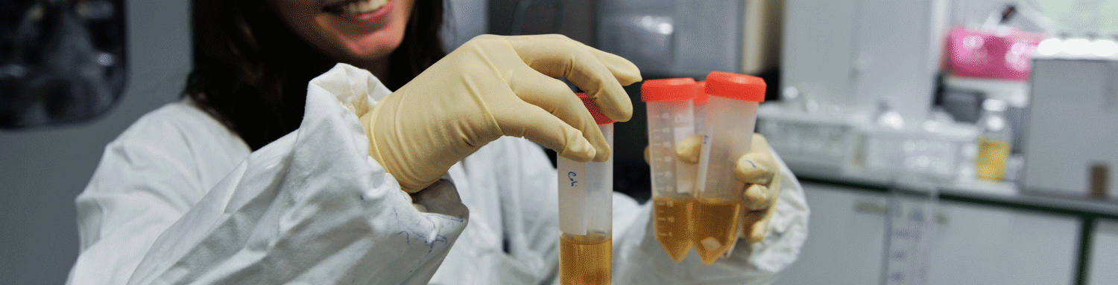
research
• 31 Research Centres
65% rated Excelent, Very Good or integrated into Associated State Laboratories.
Hosts the European Institute of Excellence in Tissue Engineering and Regenerative Medicine, the only Institute of this kind to have a base in Portugal.

Slide 7
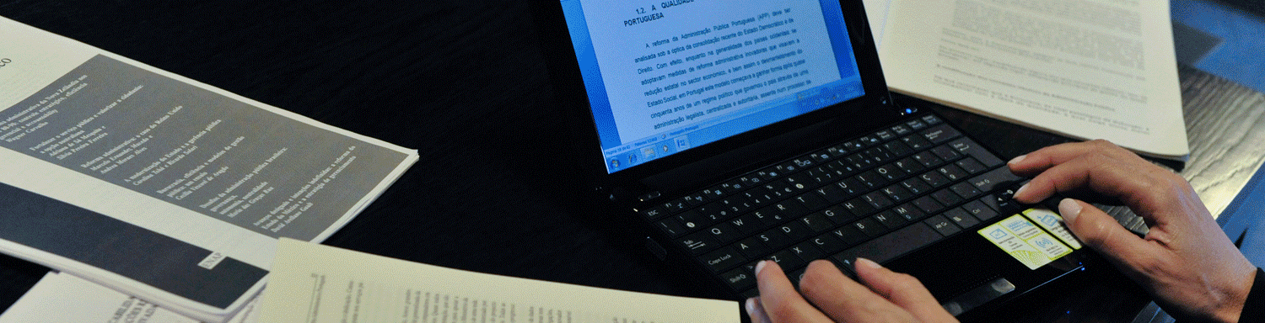

University of Minho
An Open Access pioneer
[2003-2012]

Slide 8
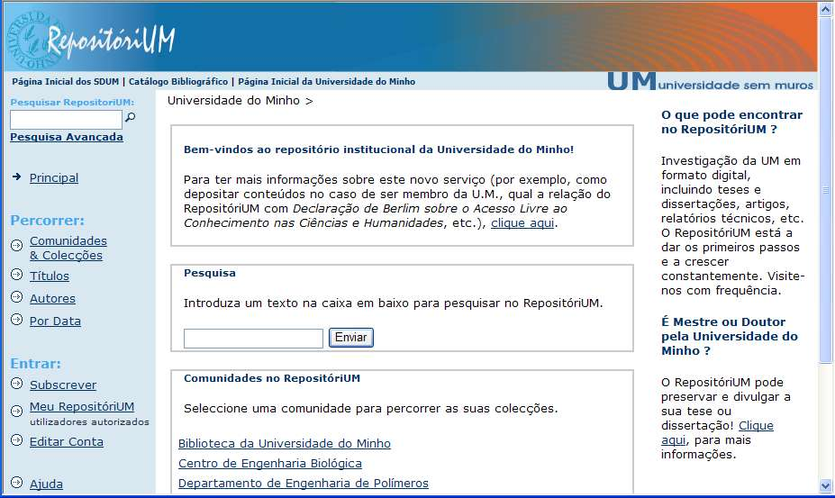
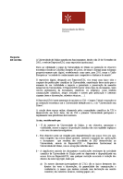
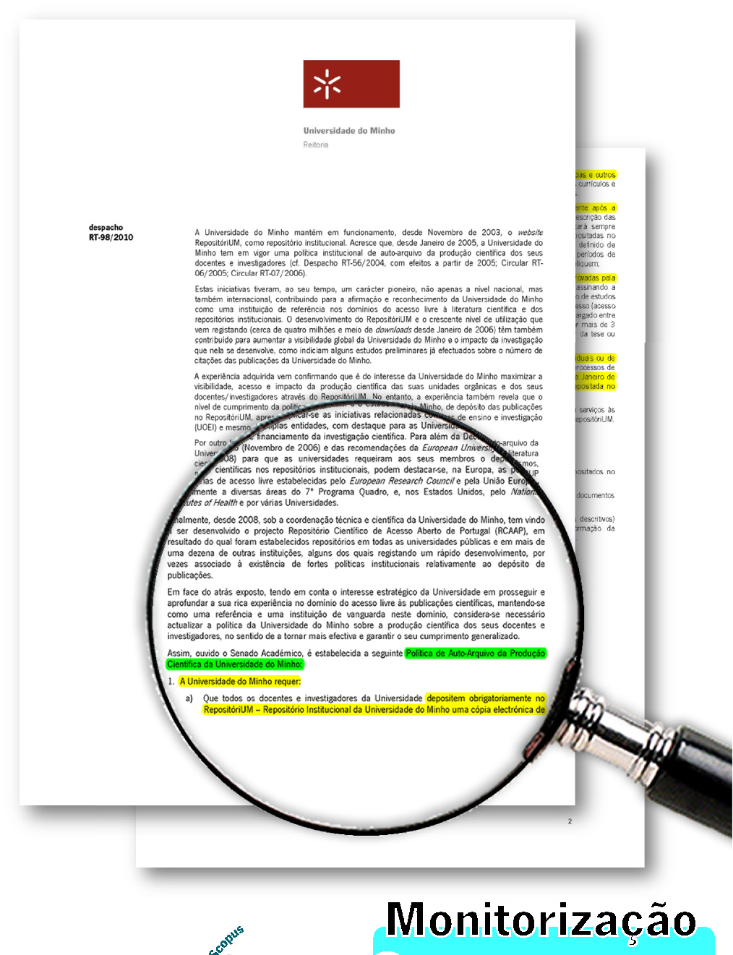
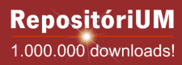

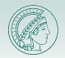


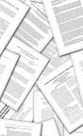
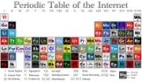




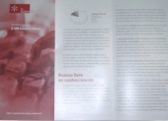
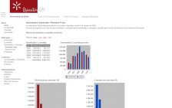




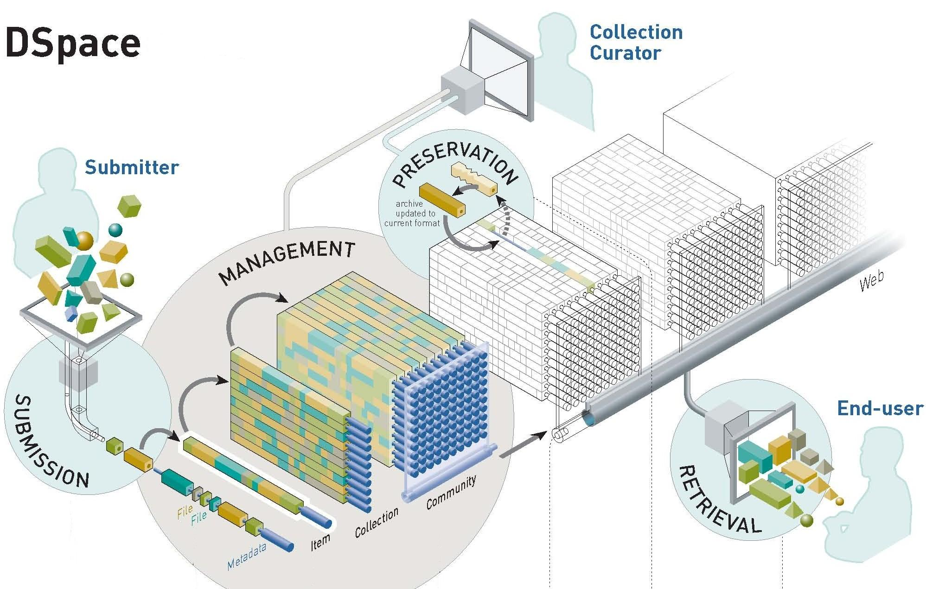




Open Access @UMinho timeline

Slide 9
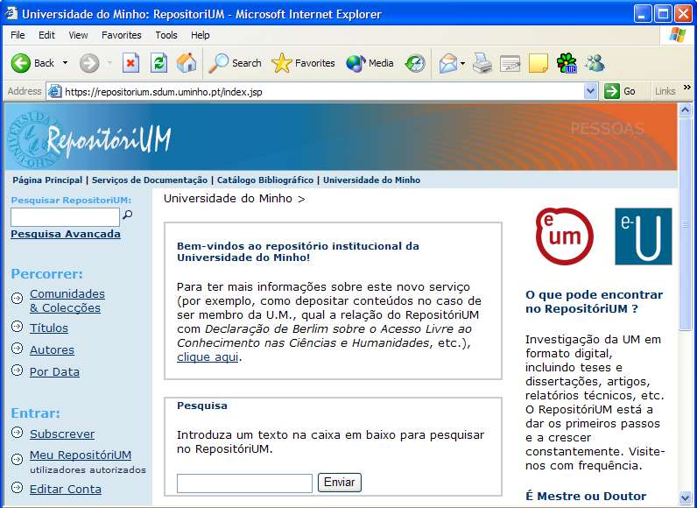
RepositóriUM (2003)
Publicly launched in November 2003
Deposition of publications by author (or “proxy”) self-archiving
No library mediated deposit/archiving
Notes:
Este projecto foi iniciado em Maio de 2003 e teve essencialmente 4 Fases.
A 1ª fase de implementação foi de Instalação, Configuração, Tradução e Formação
Após instalação da infra-estrutura física e lógica, e efectuada uma análise mais aprofundada de todas as suas funcionalidades, foram iniciadas as tarefas de configuração, desenvolvimento da interface gráfica, personalização e tradução da interface para a língua portuguesa.
Posteriormente foi dadas sessão de formação dos técnicos envolvidos em tarefas associadas ao novo sistema.

Slide 10

UMinho self-archiving policy (2004)
This policy was established by a Rectoral Document, in the first anniversary of RepositóriUM
Following the signature of the Berlin Declaration in November 2004
Implemented from January 1st 2005

Slide 11
UMinho self-archiving policy (2004)
University of Minho staff must archive their publications and documents into RepositóriUM, and make them available in Open Access whenever possible;
The organisational units (research centres, departments) must sign and adopt self-archive policies for the scientific output of their members, based upon a general model;
Authors of thesis and dissertations approved by the University of Minho must authorise the deposit of their thesis or dissertation into the RepositóriUM.

Slide 12
Self-archiving incentive
In 2005 the Rectory provided a financial supplement to departments and research centres, proportional to their compliancy to the policy of Open Access self-archiving in RepositóriUM.

Slide 13
Self-archiving incentive in 2005
The incentive was distributed through the research centres/departments, and not directly to the individual researchers
The total amount that each research centre/department received was calculated as a function of:
  Type of documents self-archived (peer-reviewed journal articles = 1; peer-reviewed/accepted conference papers = 0,5; other documents = 0,1);
  Date of publication (2004 and 2005 = 1; previous to 2004 = 0,3);
  Research Center/Department self-archiving policy (Departments that adopted a self-archiving policy based in the model of university policy = 1; Departments without that policy = 0,3).

Slide 14
Self-archiving incentive
In 2006, there was also a financial supplement, but it’s value was significantly smaller (around 1/3)
The incentive disappeared after 2006

Slide 15
Results

Slide 16
But…
Not having the incentive, and no enforcement /monitoring authority from 2007 to 2010...

Slide 17
Results

Slide 18
Upgrade of UMinho OA policy (2010)

Slide 19
University of Minho
An Open Access pioneer
[2003-2012]
OA was integrated in the University Action Plan for 2009-2013

Slide 20
Upgrade of UMinho OA policy (2010)
Why?
The number and percentage of UMinho research output was decreasing since 2007
Open Acces is seen as a relevant factor on the visibility strategy of University of Minho
To continue and improve the UMinho Open Access experience, maintaining UMinho has an OA frontline institution;

Slide 21
UMinho upgraded policy (RT-98/2010)
Minho Univeristy requires:
All academic staff to mandatory deposit into RepositóriUM of a copy of all peer reviewed publications dated after January 2011;
From January 2011, all official publication lists or reports, from individual researchers and research units, submitted internally at UMinho, must contain a link to the version archived at RepositóriUM

Slide 22
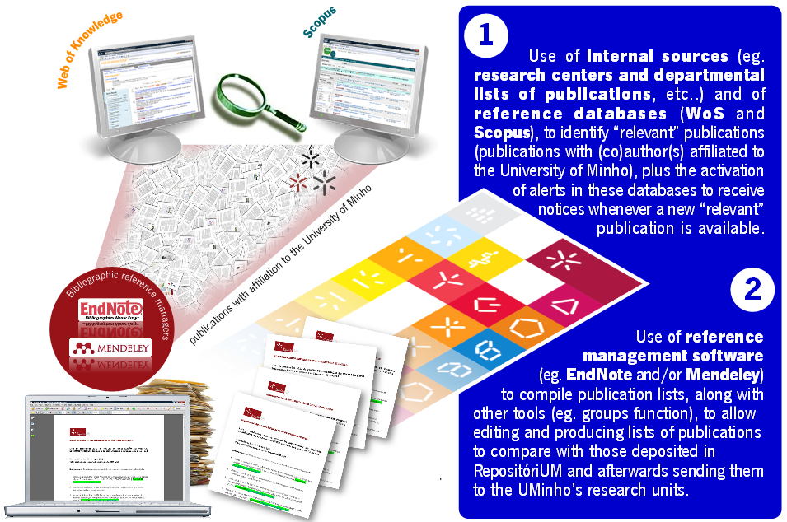
Policy monitoring

Slide 23
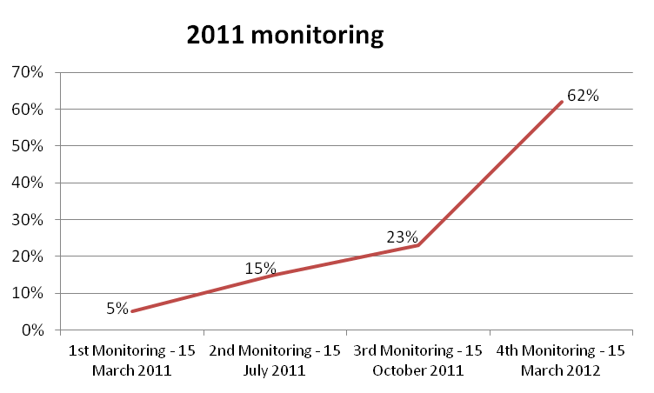
Monitoring policy compliance

Slide 24
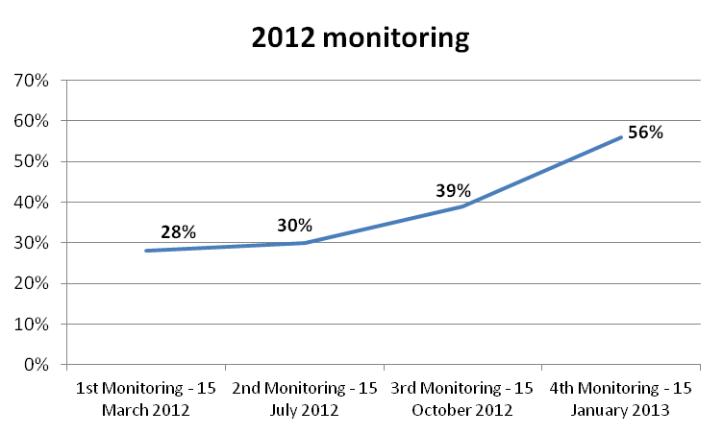
Monitoring policy compliance

Slide 25
Results

Slide 26
RepositóriUM document types

Slide 27
Access type

Slide 28
Results

Slide 29
Results

Slide 30
Last year traffic origins

Slide 31
Downloads origins

Slide 32
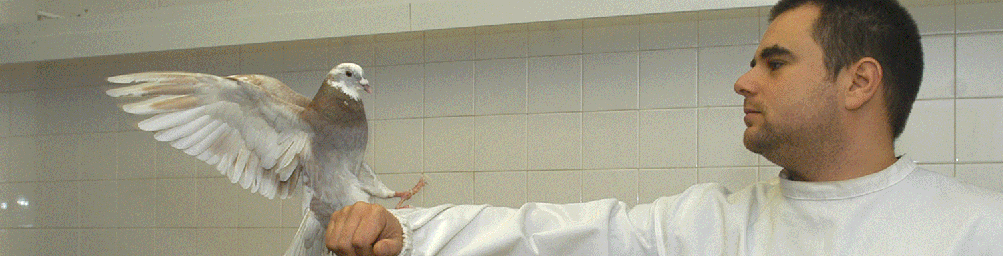
Future directions
Open Access is again part of UMinho Strategic Plan (2013-2020)
RepositóriUM will be the only information source, about publication output, for the University Information System, that will support all reporting, management and evaluation activities in the University
Experimenting with research data curation and access

Slide 33

A final invitation
Join us at UMinho in 7-8 February 2013
Registration is closing today!
http://goo.gl/ftchK

Slide 34
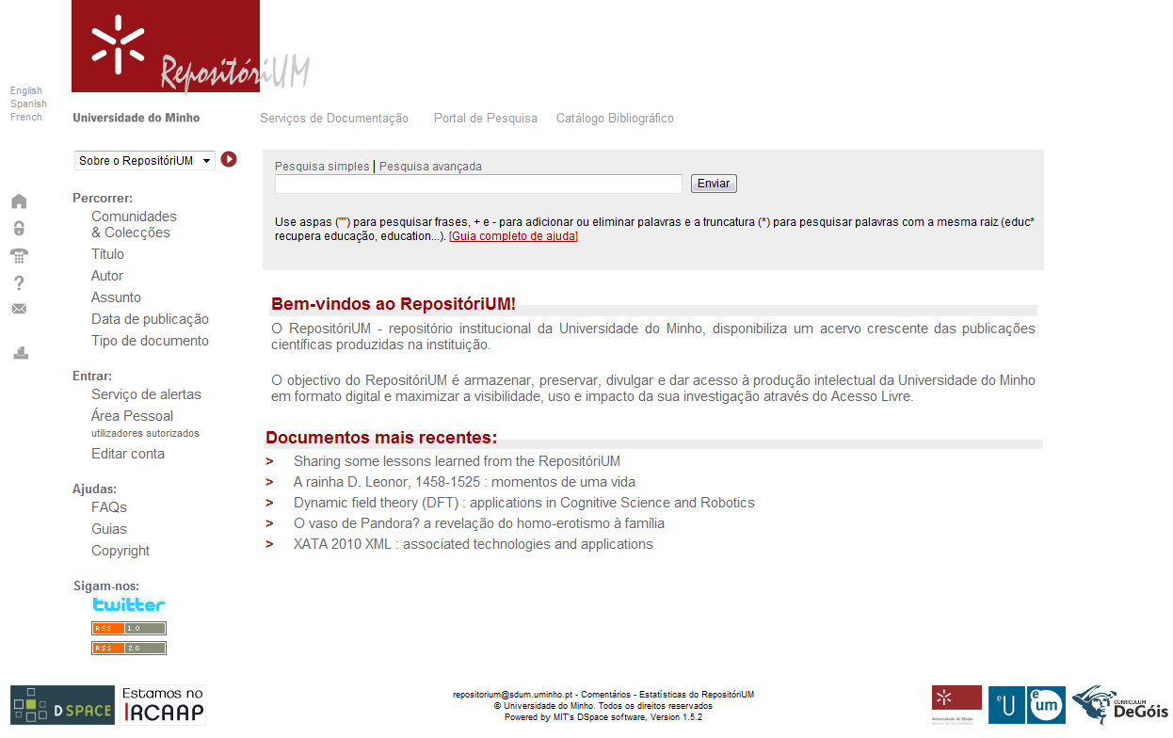
Thank you!
https://repositorium.sdum.uminho.pt

